Slide 1
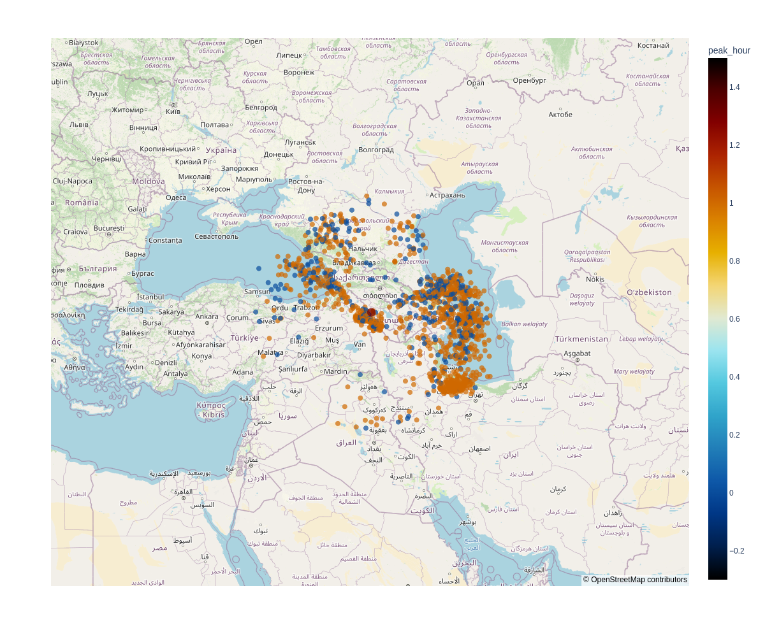
16 July 2021 Time 11:00 - 13:00
Strike Type CG
Strike Type IC
Cosmic Ray Station Aragats

