Slide 1
ALL_SKY_CAM2 (NEW)
All_SKY_CAM1

Slide 2
ALL_SKY_CAM2 (NEW)
All_SKY_CAM1

Slide 3
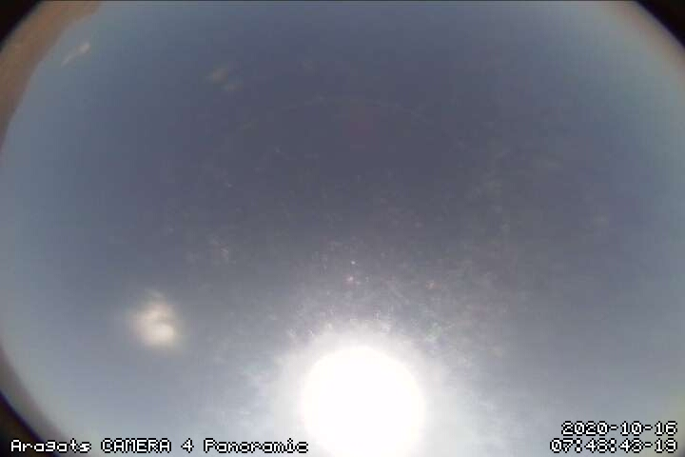
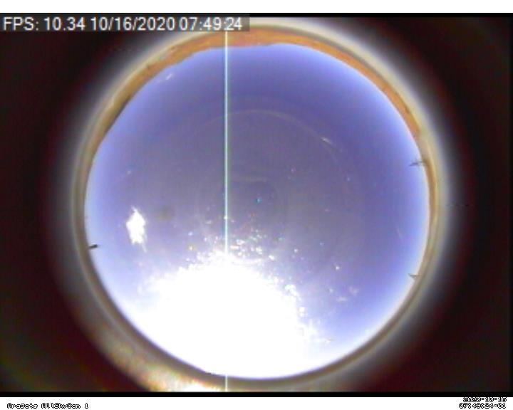
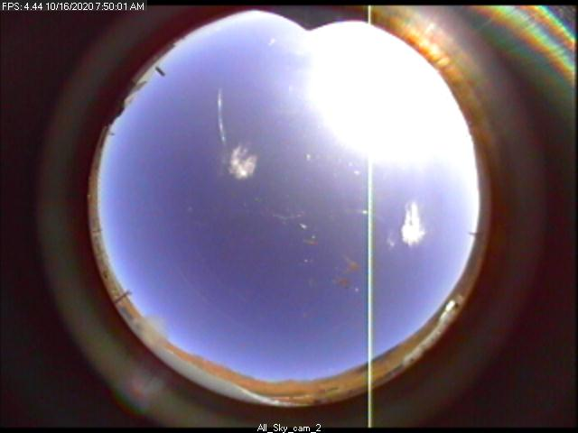
Machtayi Cam
All_SKY_CAM1
ALL_SKY_CAM2 (NEW)

