Slide 1
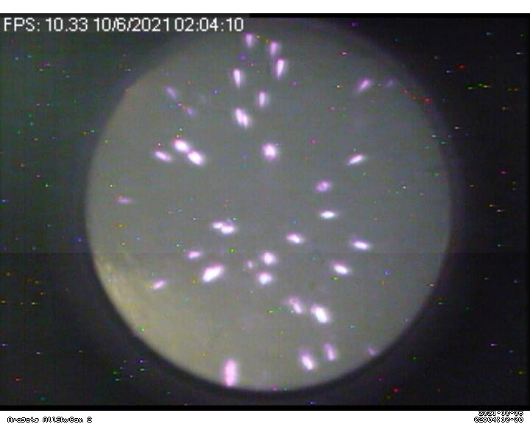
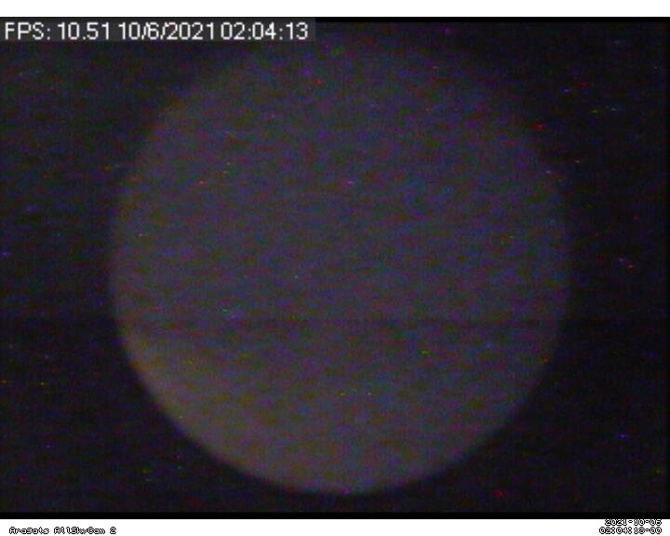
AllSKY _ Cam_1 lightning 02:04:11 and 02:04:12

Slide 2
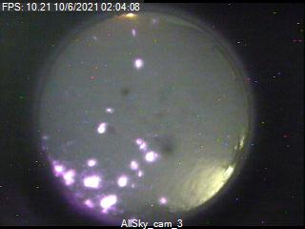
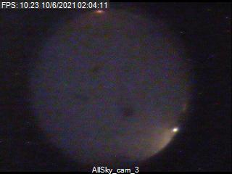
AllSKY _ Cam_3 lightning 02:04:09 and 02:04:10

Slide 3
AllSKY _ Cam_1 lightning 02:06:26 , 02:06:27 and 02:06:29

Slide 4
AllSKY _ Cam_3 lightning 02:06:25 , 02:06:26 and 02:06:27

Slide 5
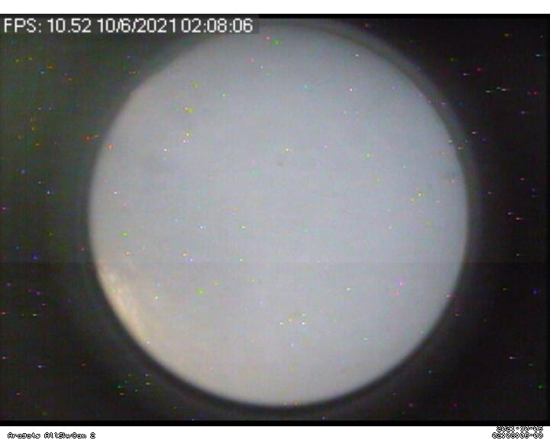
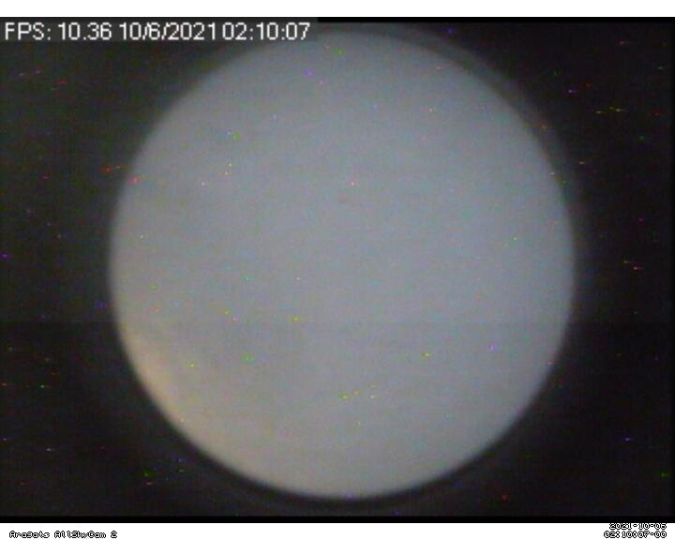
AllSKY _ Cam_1 02:08:07 ic minch 02:10:05 chi nkarel

Slide 6
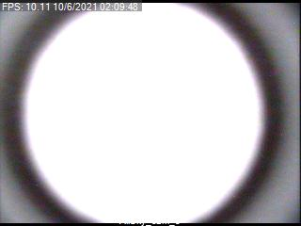
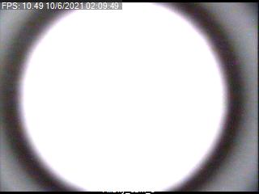
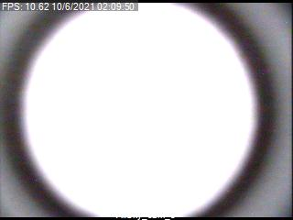
AllSKY _ Cam_3 lightning 02:09:48 , 02:09:49 and 02:09:50

