Slide 1
October 6, 2021. TGE terminated by lightning flashes Time Lightning type (preliminary) 01:54:02.362 UT -CG, multiple RS pulses 02:04:05.232 UT inverted IC Flashes were not detected by WWLLN.
For first flash, polarity of ΔE is positive both in Aragats and Nor Amberd. Multiple strong pulses are, most probably can be interpreted as return strokes , though the shape is not typical. Distance to lightning D=6.4 km (according to EFM in MAKET).
For second flash, polarity of ΔE is negative both in Aragats and Nor Amberd.
Probably, the polarity reversal distance was larger than 13 km between Aragats and Nor Amberd, this means that the flash occurred at high altitude. Fast field record of second flash is weak small pulses on high 50 Hz background, difficult to interpret. Presumably, this was inverted IC . D=5.3 km.

Slide 2
Electric field MAKET and count rate of Cube 6 detector ( myRIO DUVIK ch 8)
01:54:02.362 UT
02:04:05.232 UT
02:03:04

Slide 3
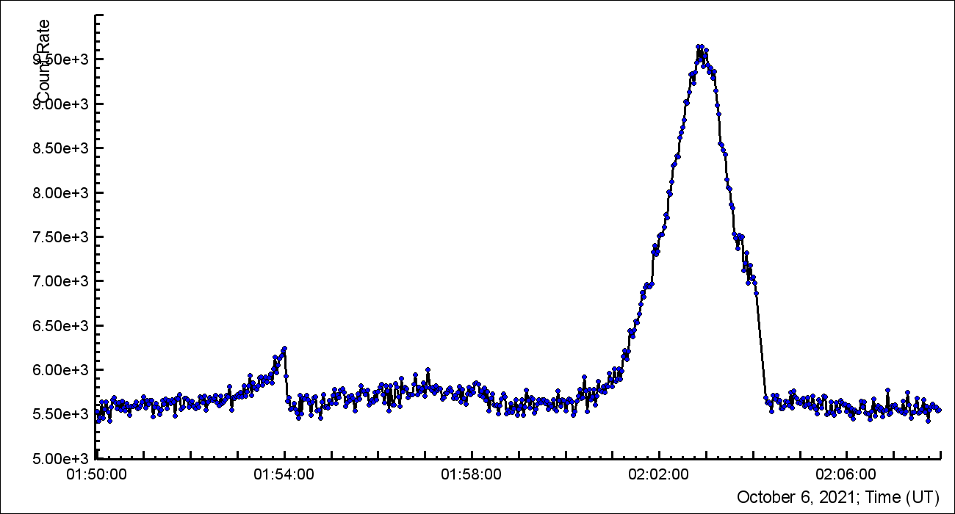
October 6, 2021. TGE terminations Count rate of ASNT Coincidence One 60-Zero5
TGE terminations
02:04:05.232 UT
01:54:02.362 UT
Aragats
Nor Amberd

Slide 4
Oct. 6, 2021, 01:54:02 UT. Picoscope N1 in SKL
NaI N2
Flat plate antenna
Zoom in next slide

Slide 5
Oct. 6, 2021, 01:54:02 UT. Picoscope N1 in SKL
50 µs

Slide 6
Oct. 6, 2021, 02:04:05 UT. Picoscope N1 in SKL
NaI N2
Zoom in next slide
Flat plate antenna

Slide 7
Oct. 6, 2021, 02:04:05 UT. Picoscope N1 in SKL
5 µs

Slide 8
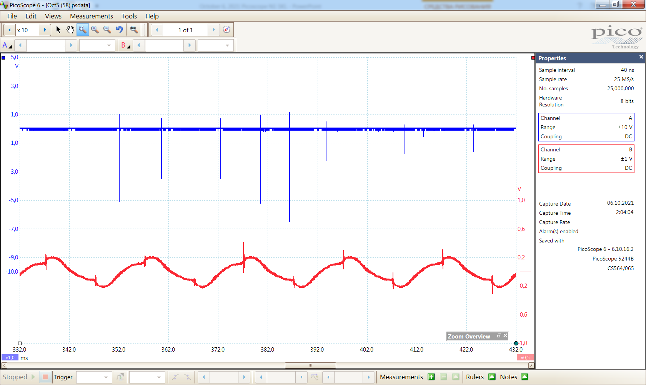
Oct. 6, 2021, 02:04:05 UT. Picoscope N1 in SKL Zoom of slide 6. True particle count pulses in NaI channel: 9 pulses in 80 ms
10 ms
pulse from ightning flash

