Slide 1
Sunrise and sunset directions
The exact directions of sunrise and sunset can be found here:
https://www.timeanddate.com/sun/armenia/yerevan
and illustrated here
http://suncalc.net/#/39.9543,44.995,5/2021.06.13/16:23

Slide 3
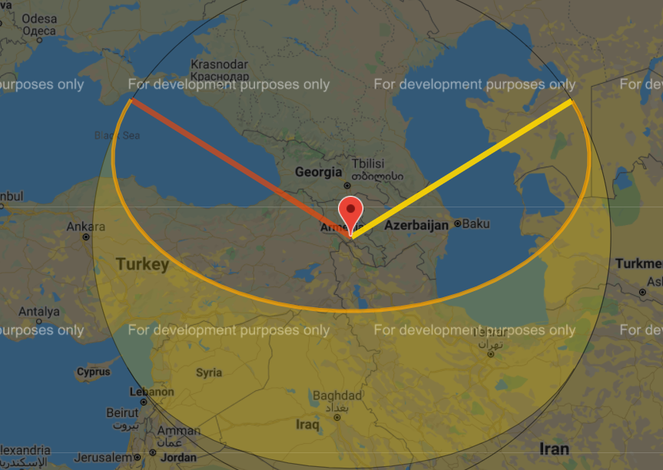
North
Sunset
Sunrise
58°(360-302)
58°
South

Slide 4
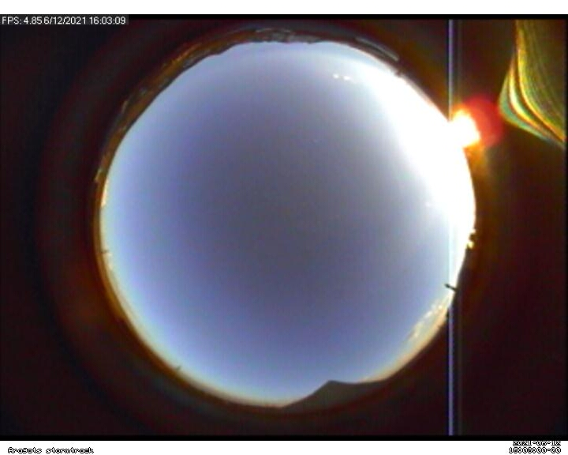
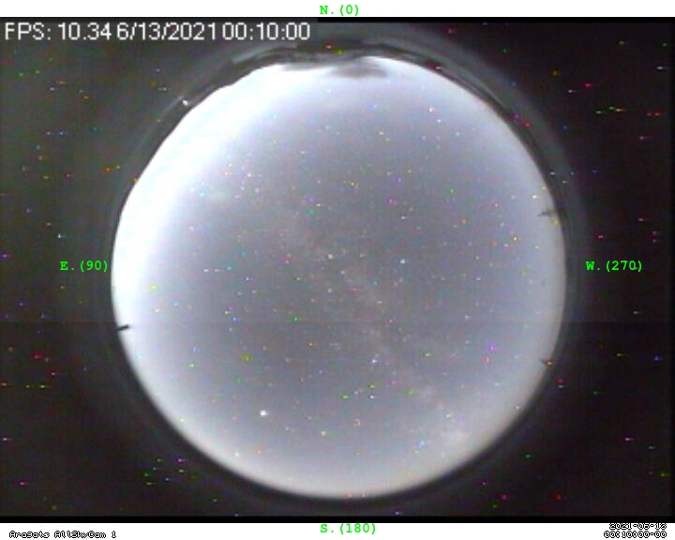
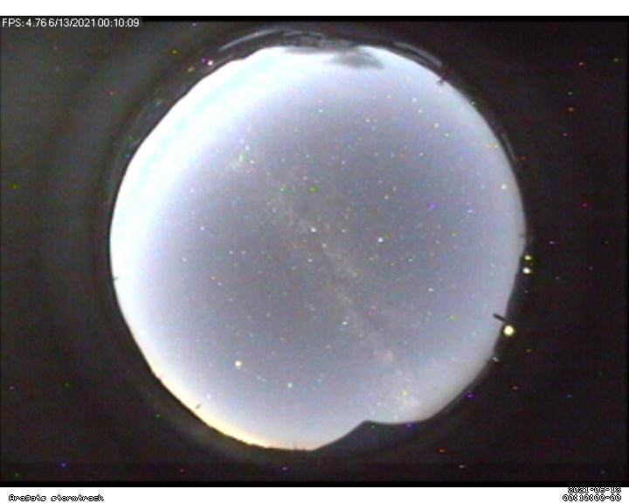
Sunset
58°
58°
Piramida
Sunrise
58°
Mast
58°
Hotel lights
chimney
chimney
Piramida

Slide 5
Sunset
58°
58°
Sunrise
58°
58°

Slide 6
Magnification of camera 2 (right one on the picture) is smaller, and its field of view is larger, as compared to camera 1.
The geographical directions (North-South, East-West) are absent in the photos taken by camera 2.
Orientation of camera 2 in respect to the geographical directions can slightly differ from that of camera 1. This difference is estimated as ≈ 2-3° (dashed black line in slide 5).
Look below on shots that leave no doubt of sky origin (there is 6-7 second shift between the on-line PC time).
Can we by comparing these shots estimate distance to light blobs in the sky?

Slide 7
58°

Slide 8
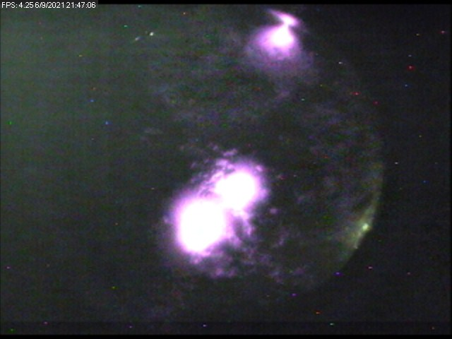
58°

