Slide 1
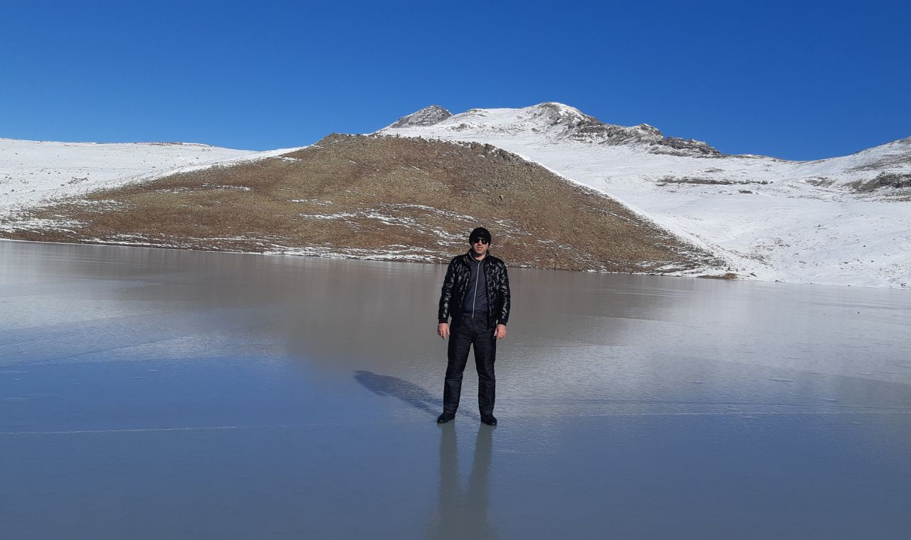

Slide 2
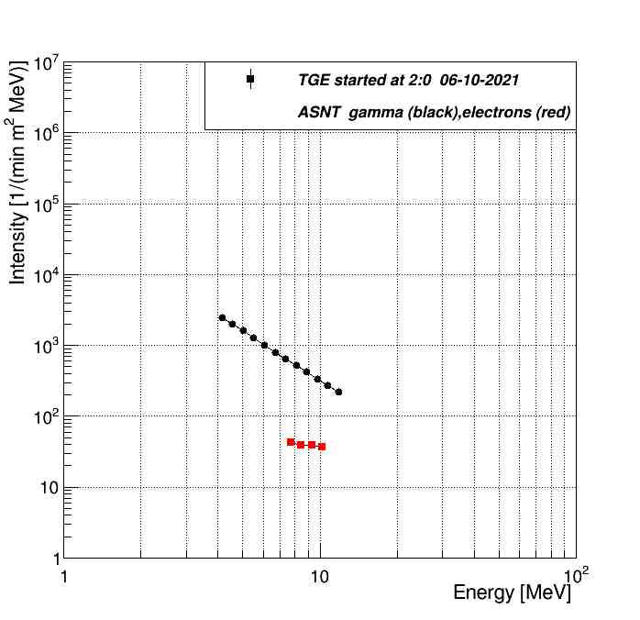
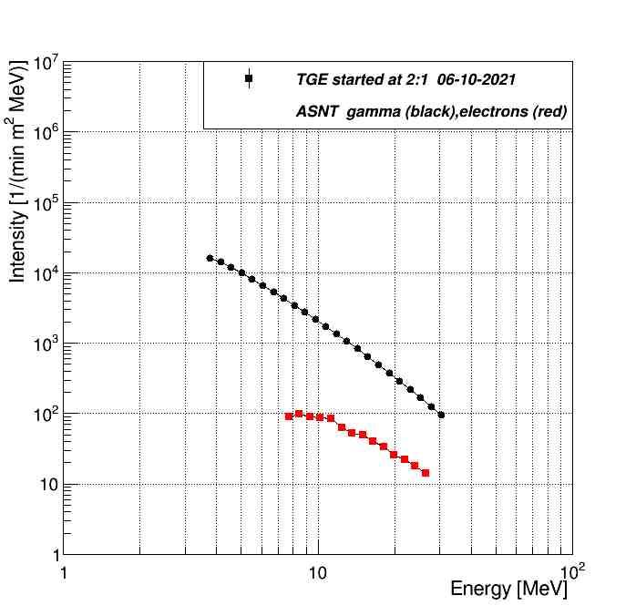
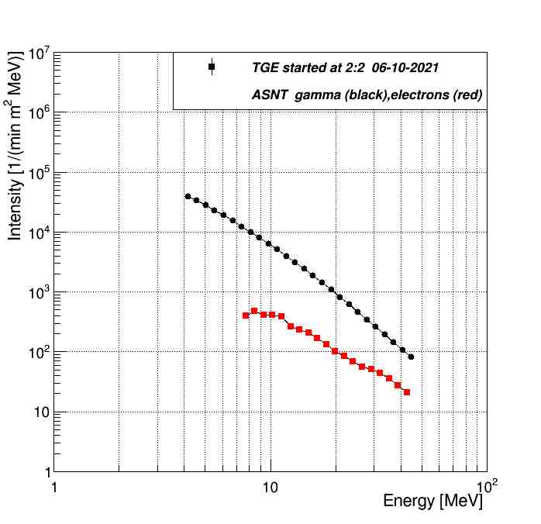
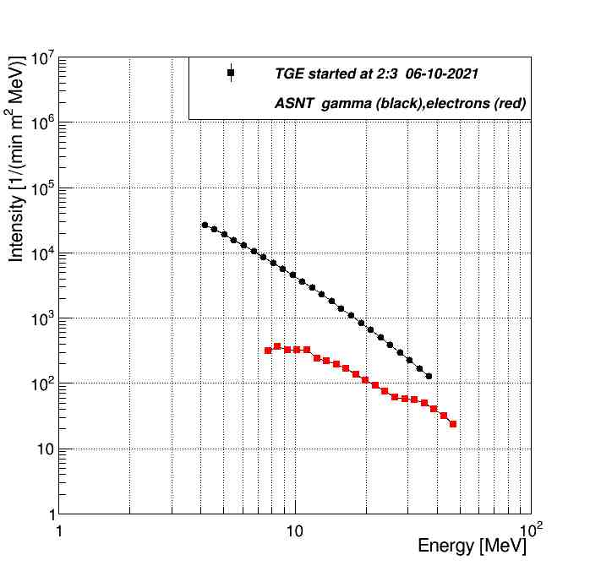

Slide 3
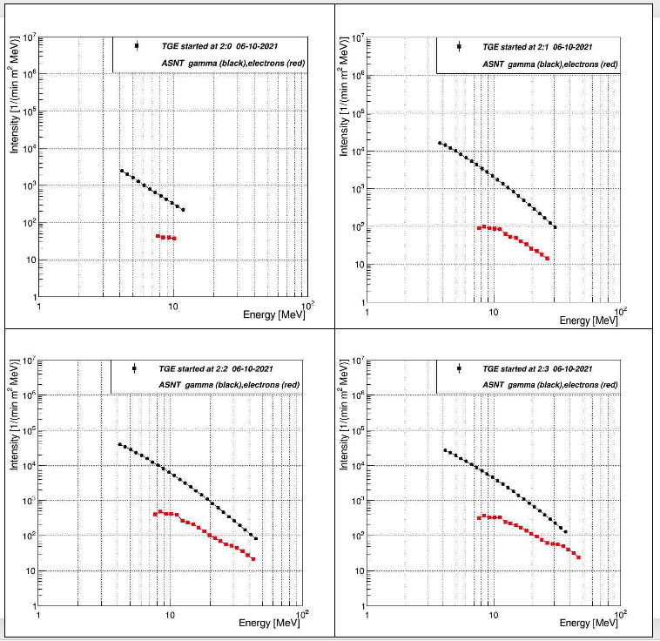

Slide 5
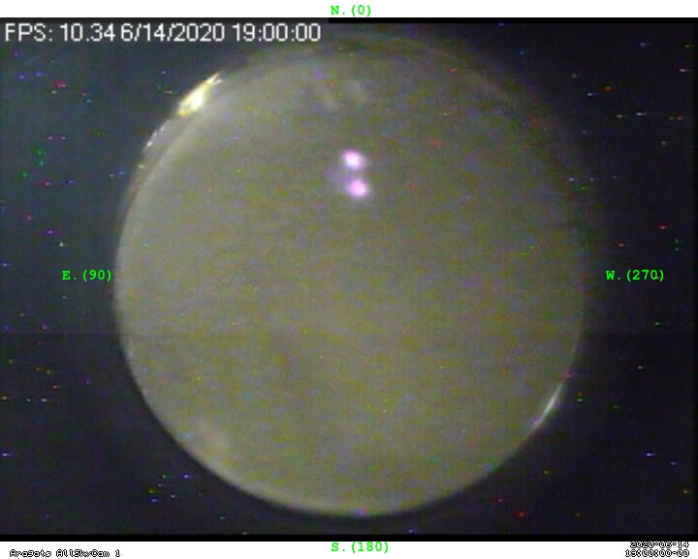
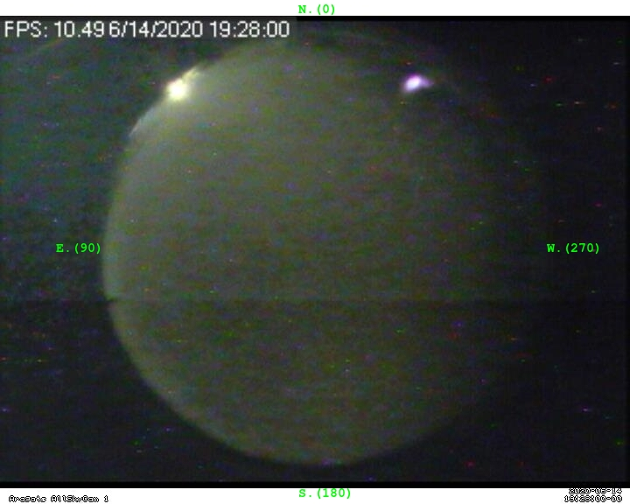
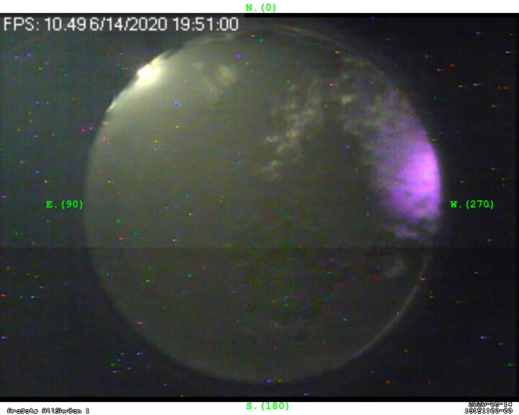
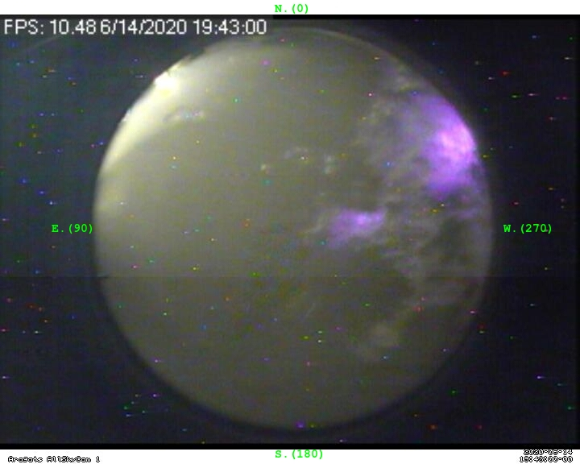
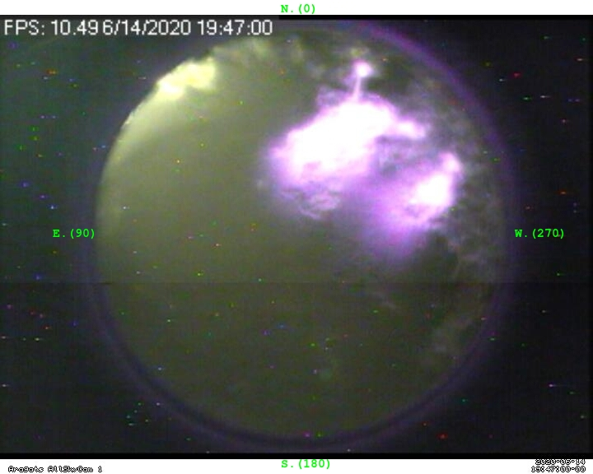
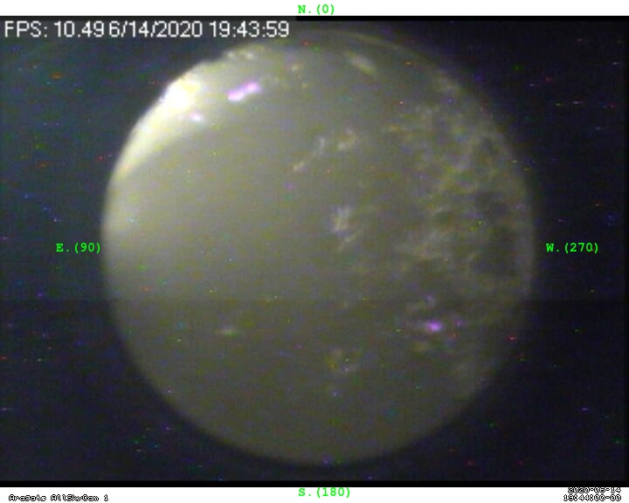
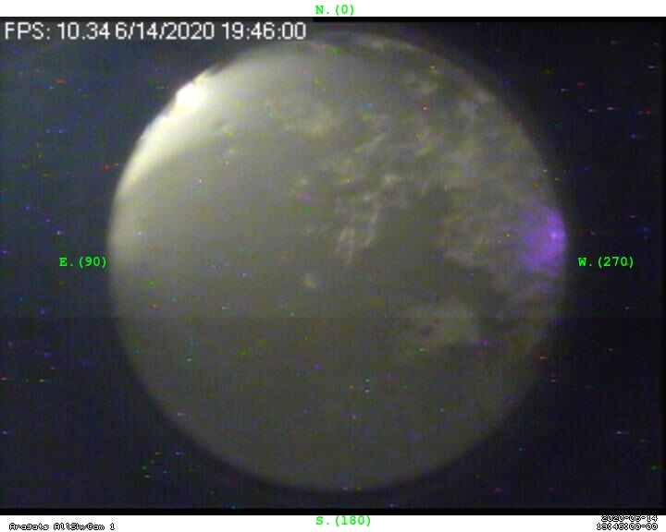
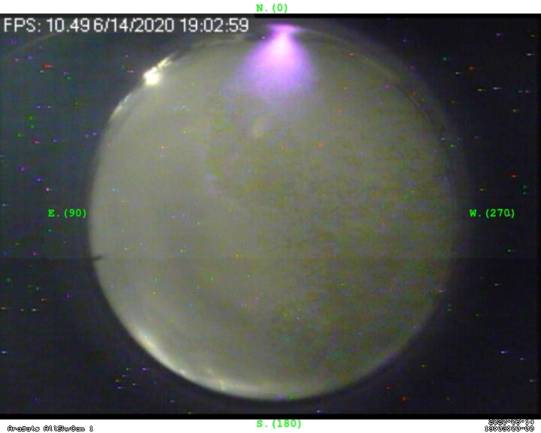

Slide 6
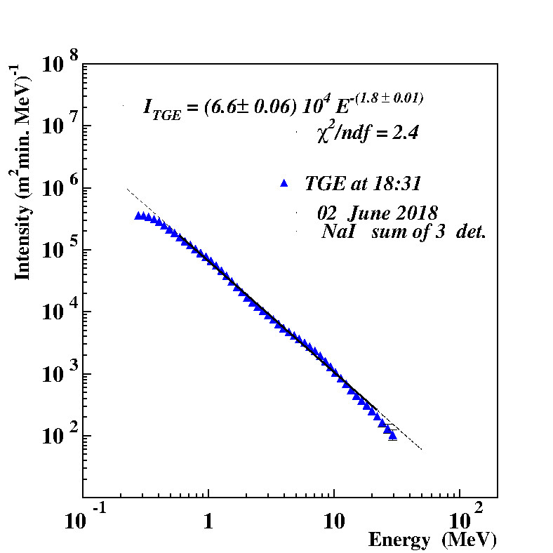
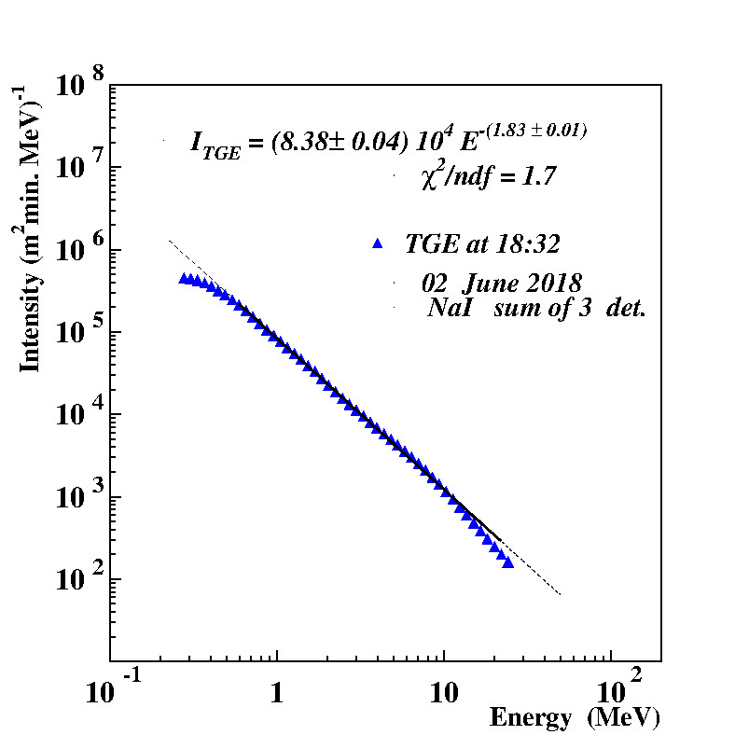
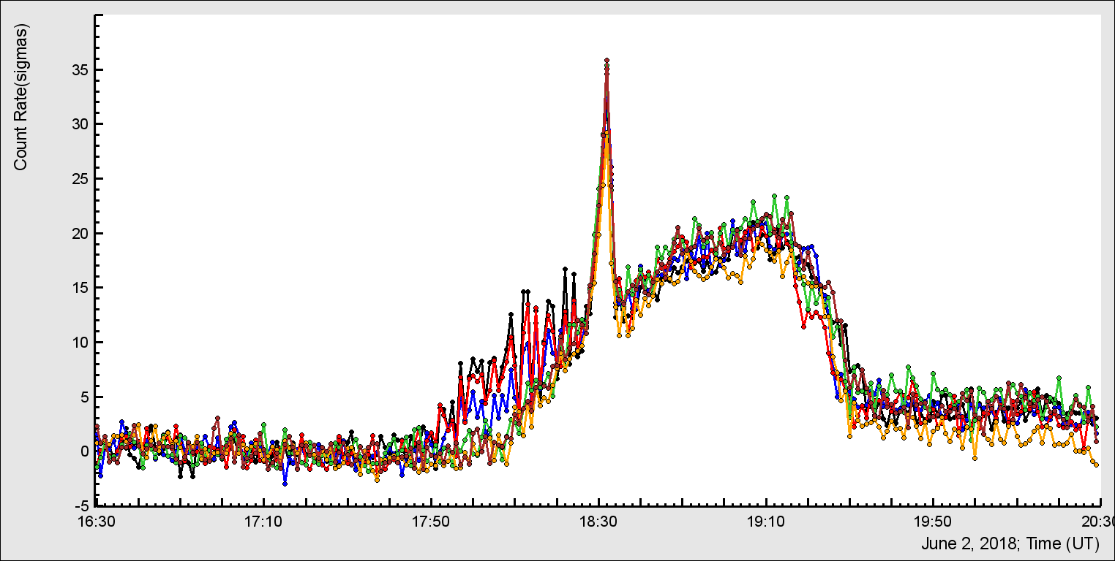
All 6 NaI crystals operate properly;
Can be used for energy spectra
recovering

Slide 8
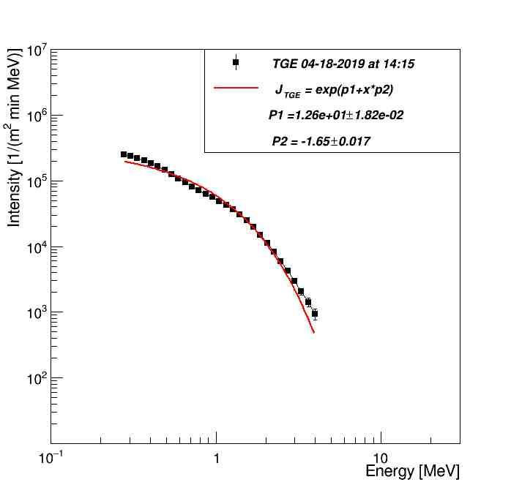
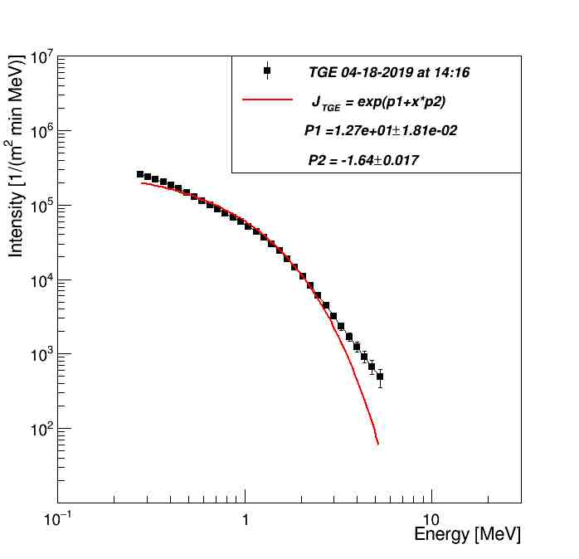
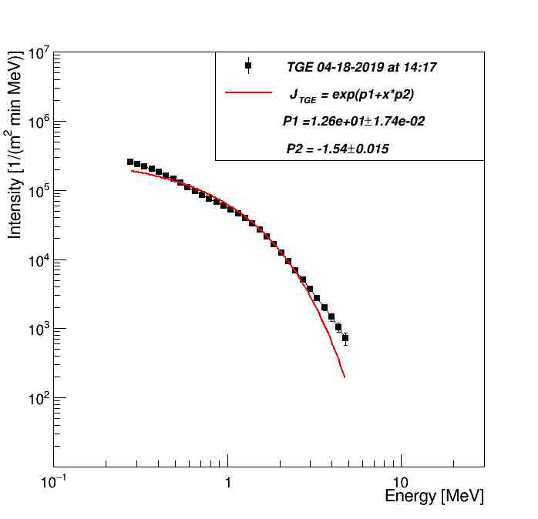
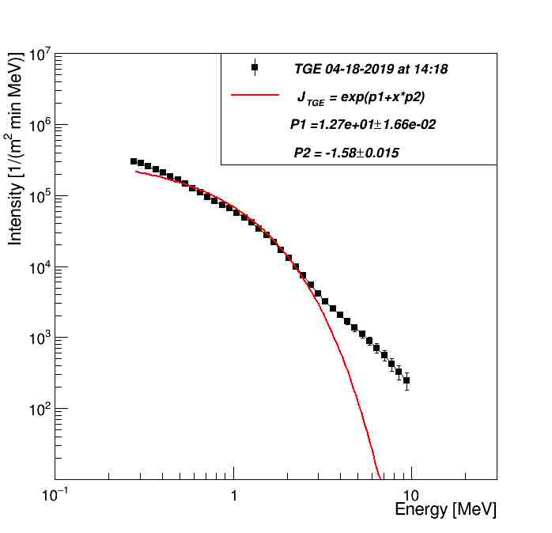
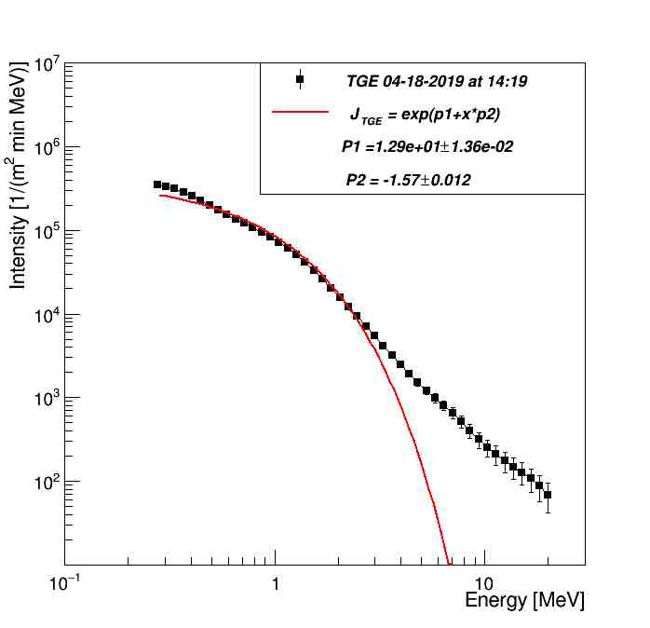
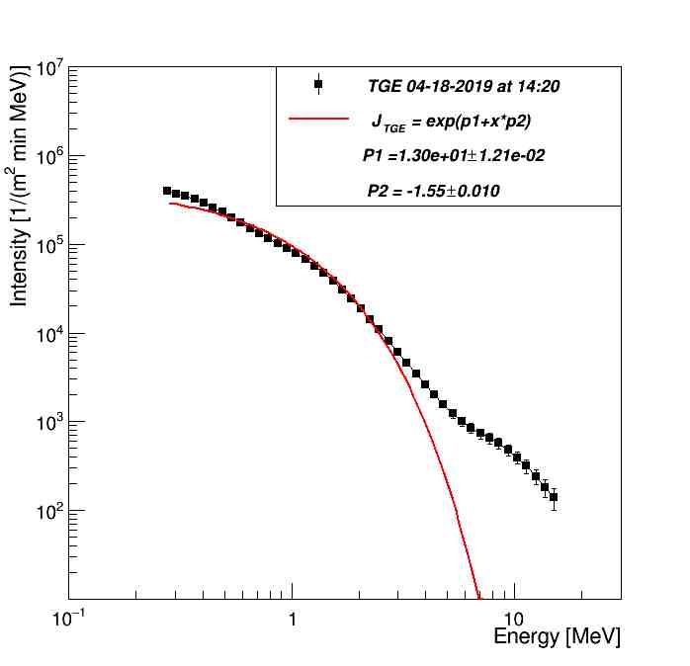

Slide 9
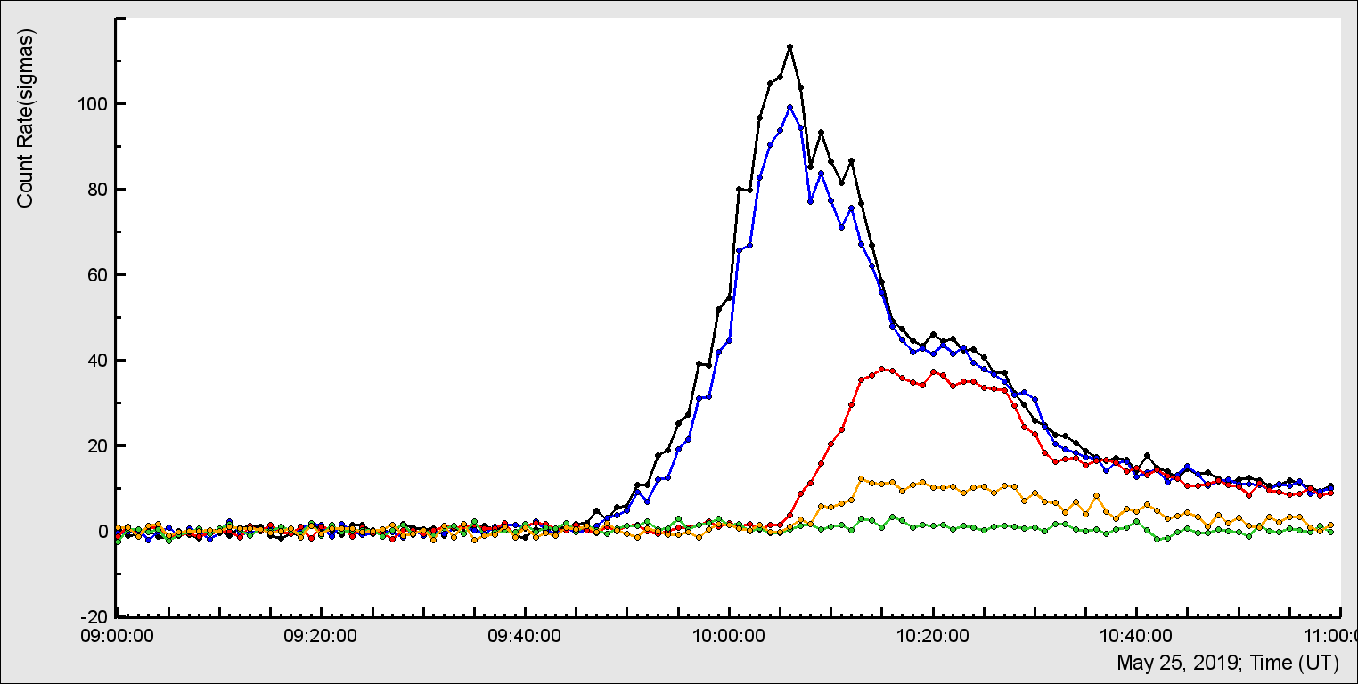
Note delay of TGE in different detectors due to various energy threshold!
>100σ TGE in NaI N 1 and 2 – the lowest energy threshold maybe 250 KeV;
NaI N4 have larger energy threshold;
NaI ORTEC have much larger energy threshold;
STAND3 upper Much smaller enhancement

Slide 10
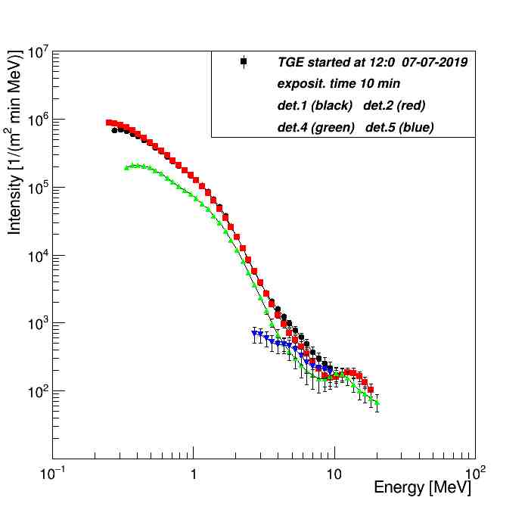

Slide 11
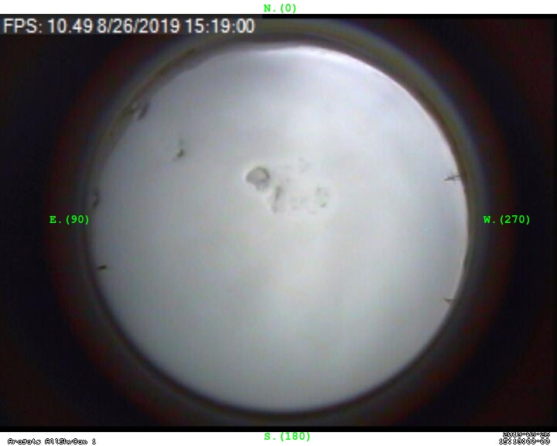
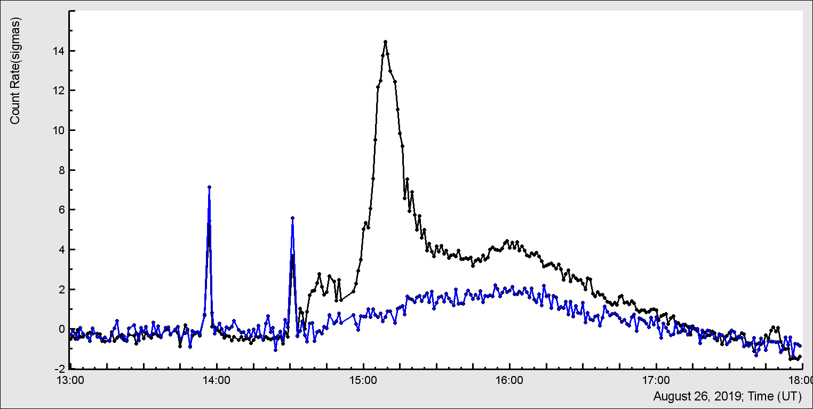
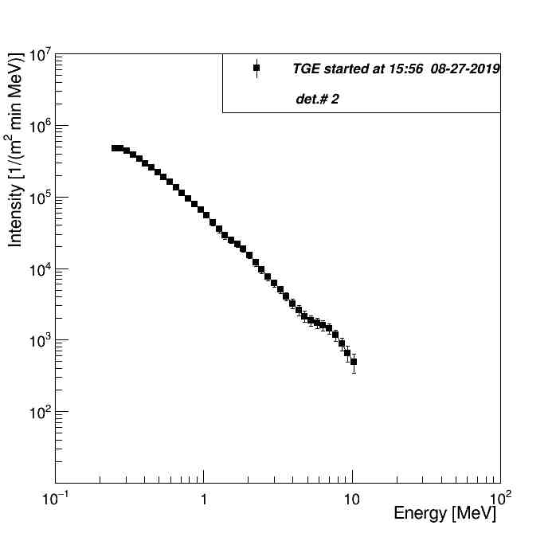
Distance to cloud’s base was (7.4 – 5.3)*122~250m; atmospheric pressure jumped ~1 mbar; Re was ~ 88%.
Melted groupel seen in middle pictures indicate charge reversal and origination of the lower dipole accelerated electrons downward!
RREA
Radon, MOS
Comparison of TGE registered by NAI 1 and 4 in number of sigmas; NaI decay constant ~ 30 minutes

Slide 12
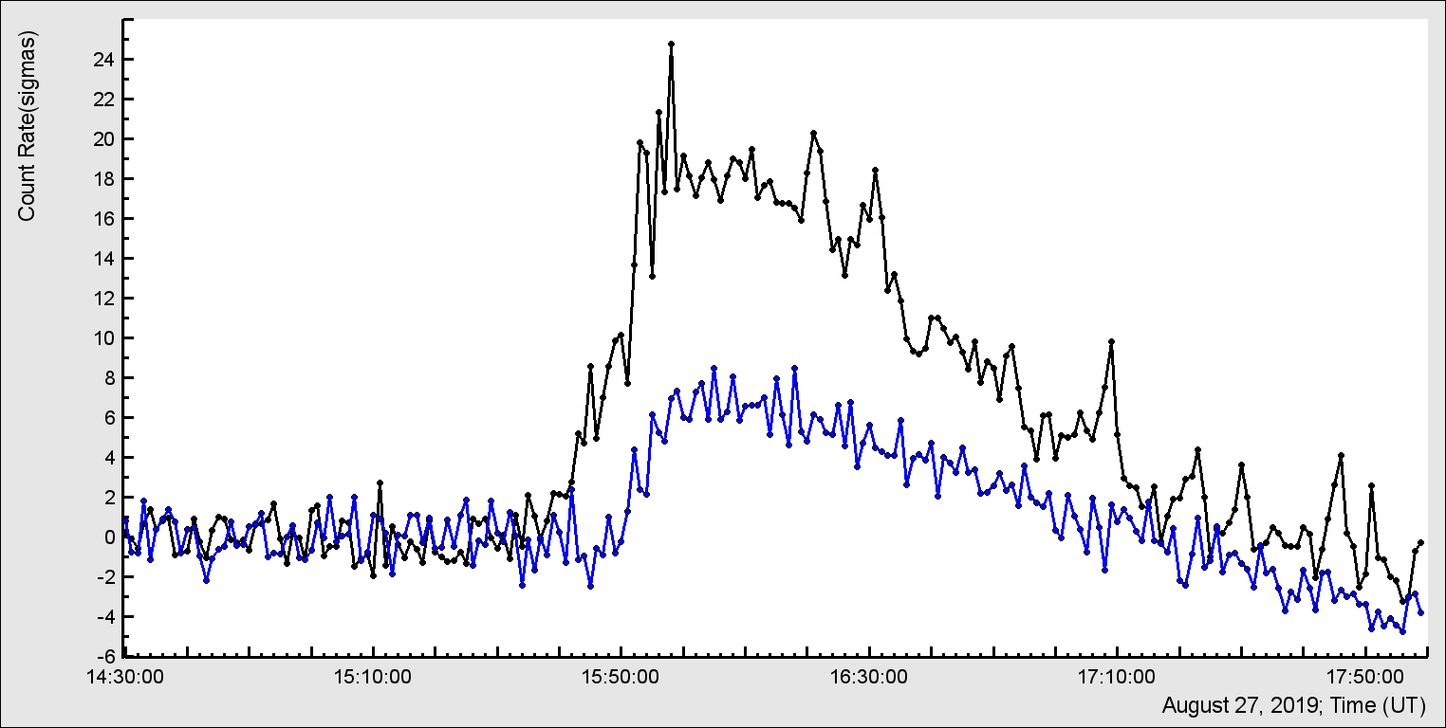
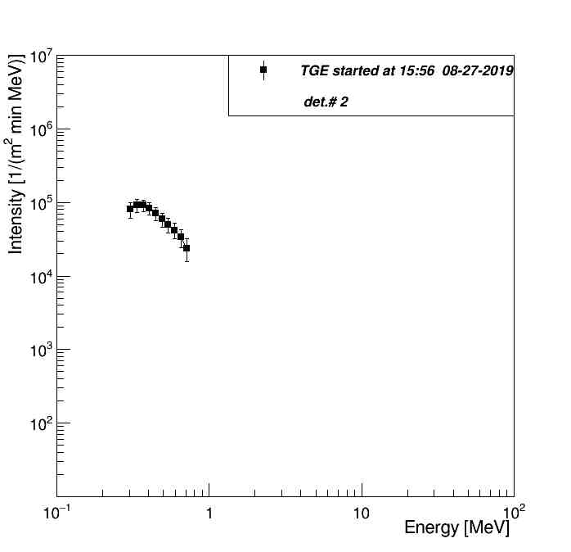
Comparison of TGE registered by NAI 1 (energy spectrum at 15:56 prolonged up to 10 MeV) and 4 (energy spectrum on 15:56 prolonged up to 1.2 MeV) in number of sigmas; NaI decay constant ~ 35 minutes
RREA
MOS

Slide 13
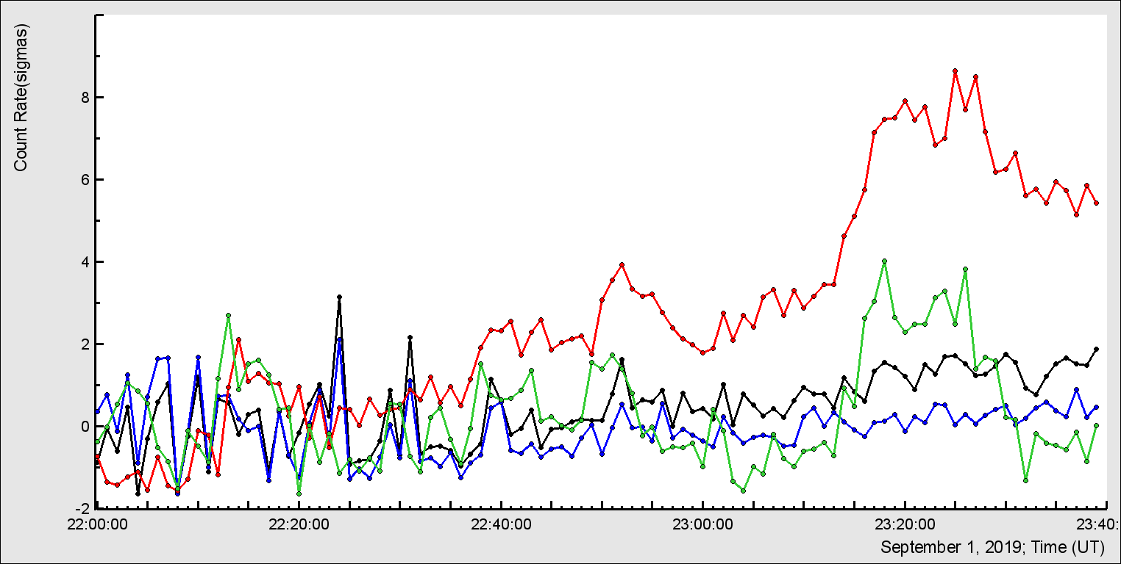
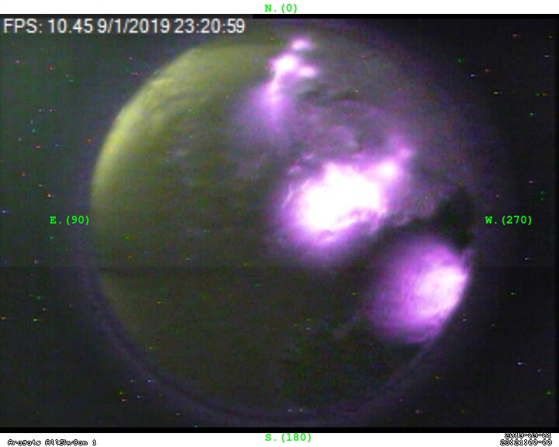

Slide 14
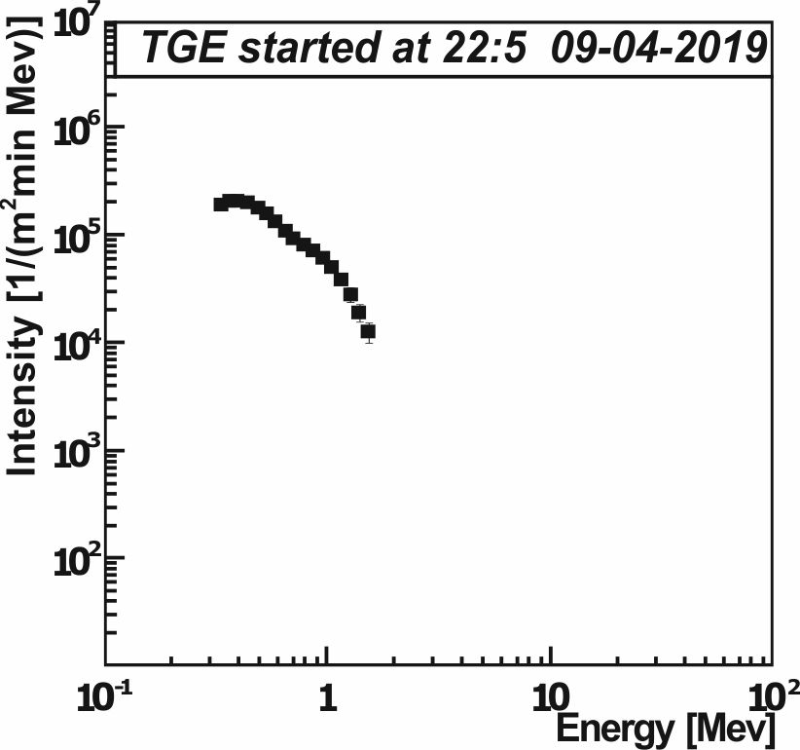
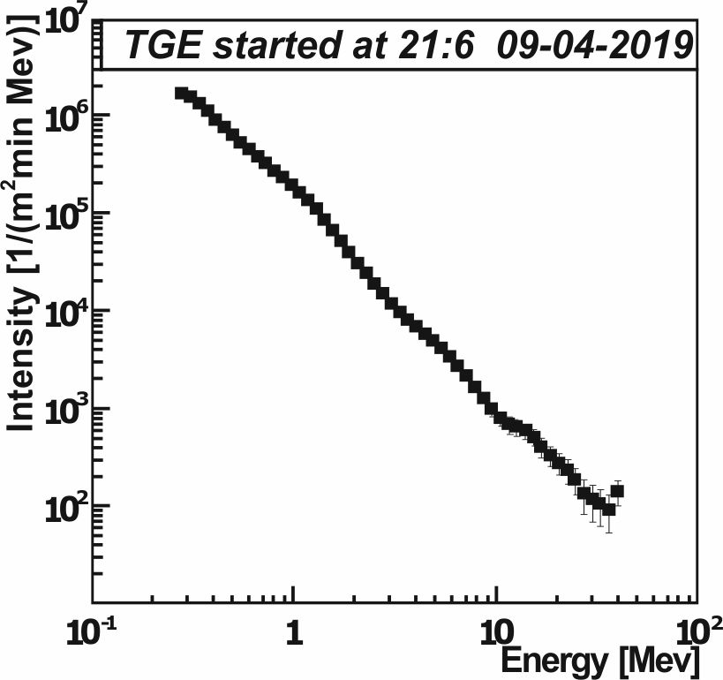
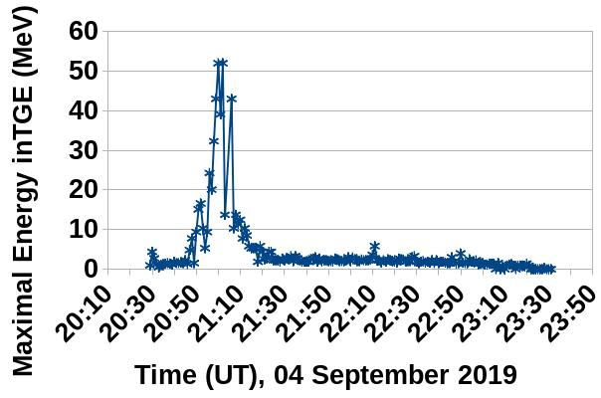
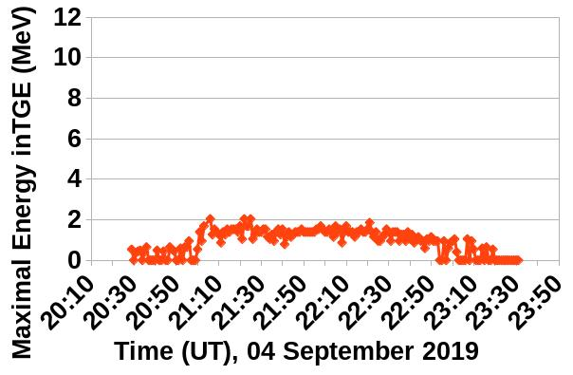
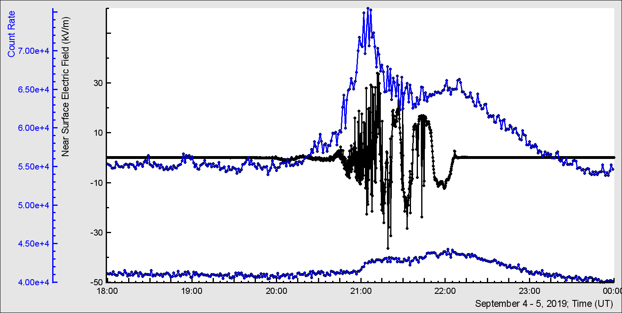
a)
b)
c)
d)

Slide 15
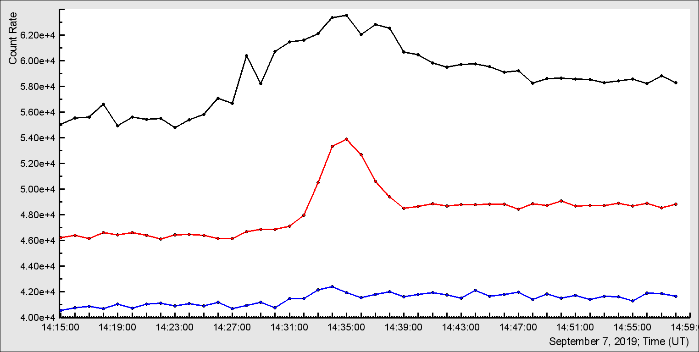
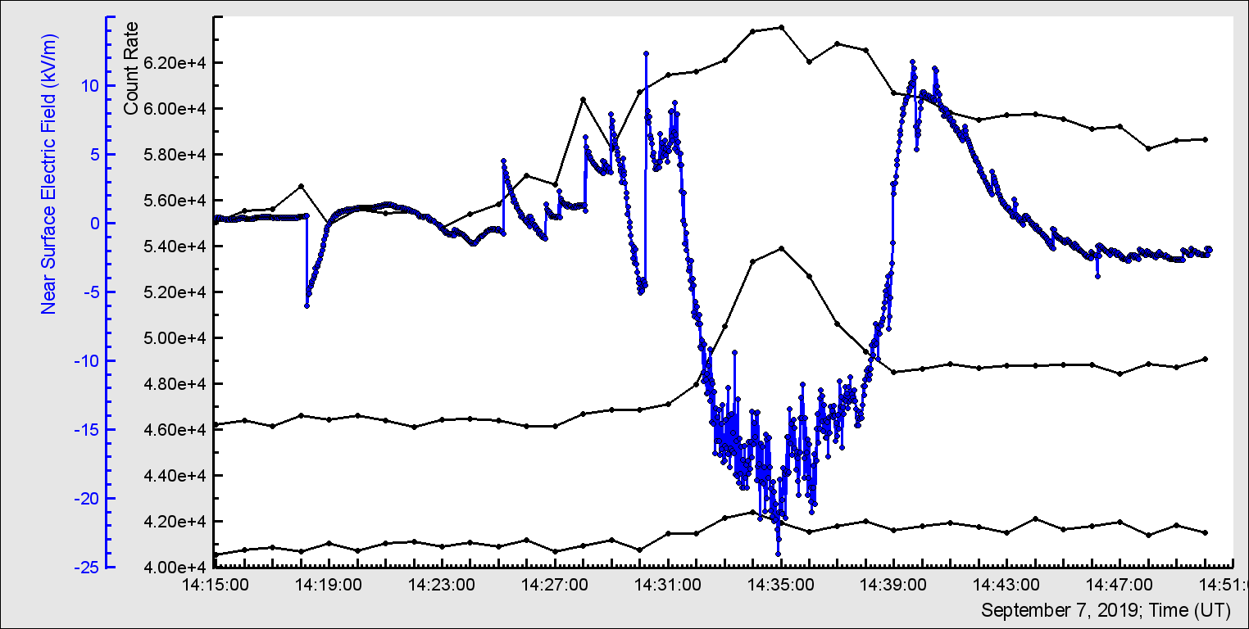
NaI N2, STAND1 and 3 upper:
positrons?

Slide 16
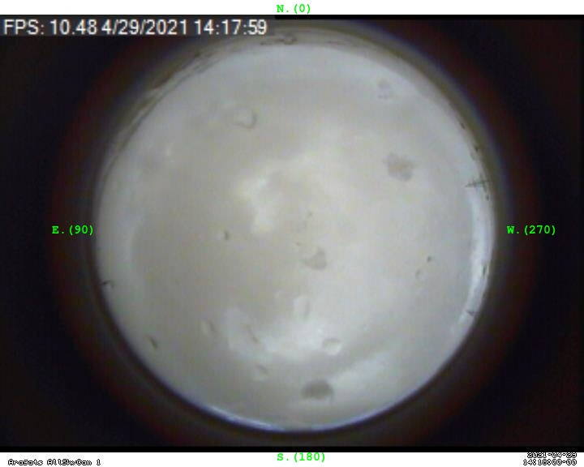
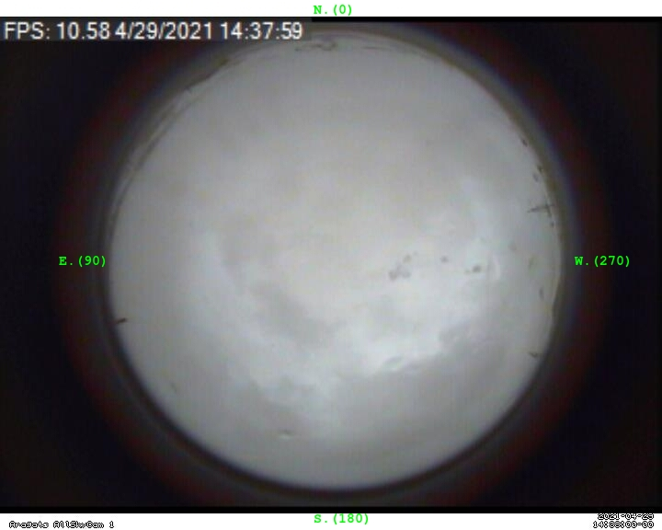
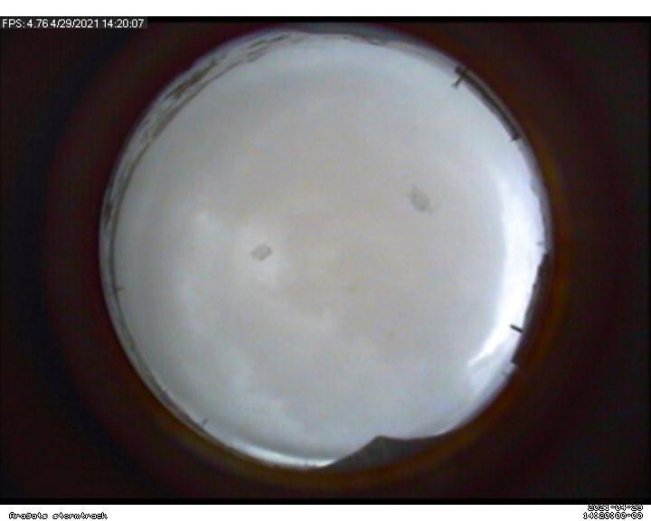
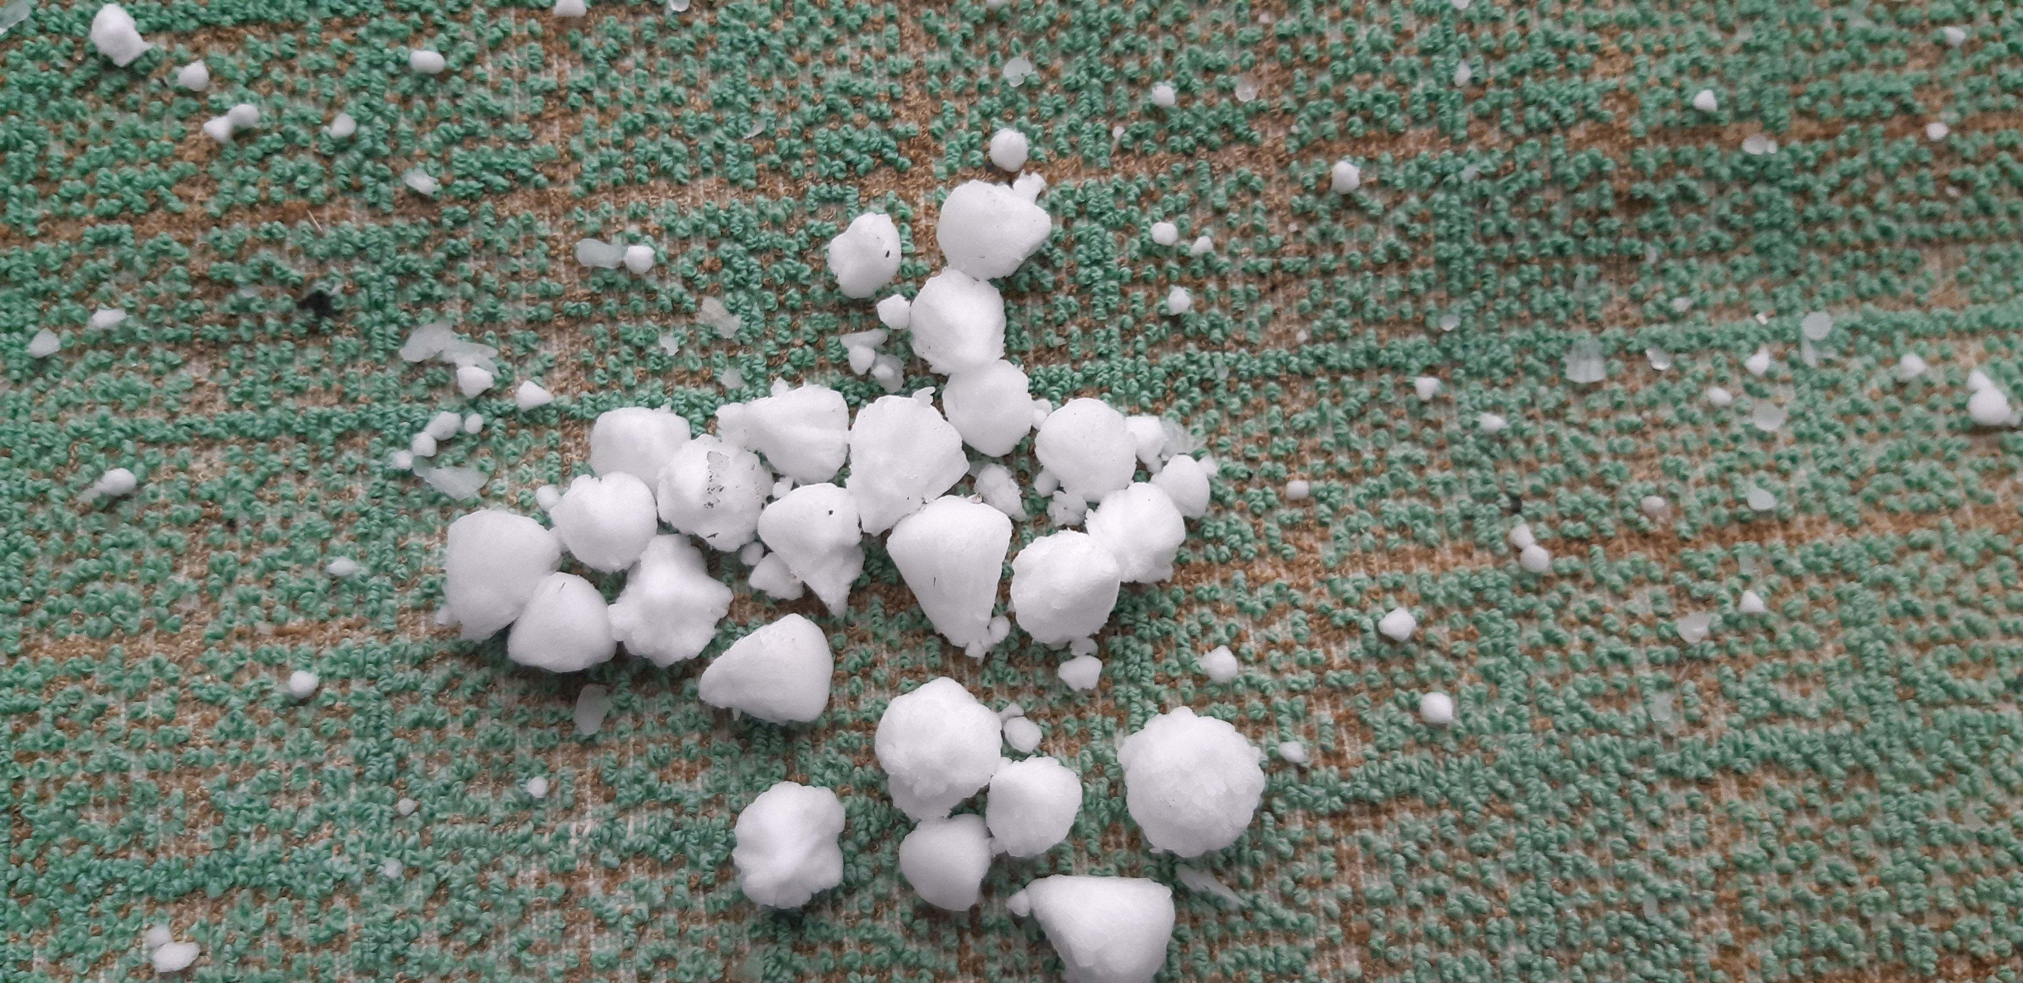
Conical graupel fall 14:18-14:38
Conical graupel fall
14:18-14:38

Slide 17


Slide 18
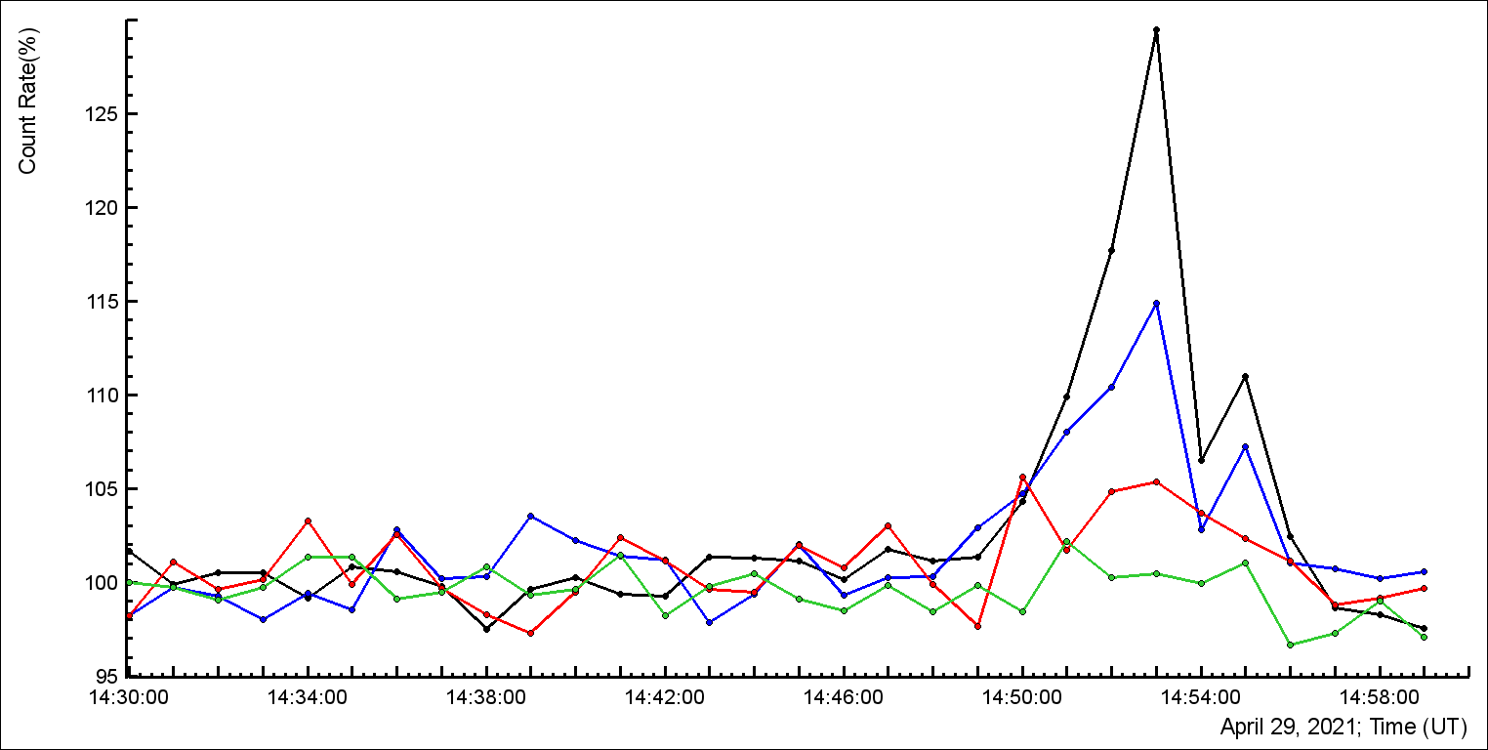
STAND3 combinations: black 1000 >3 MeV particles ≈30% enhancement

Slide 19
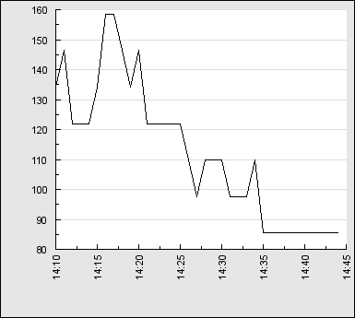
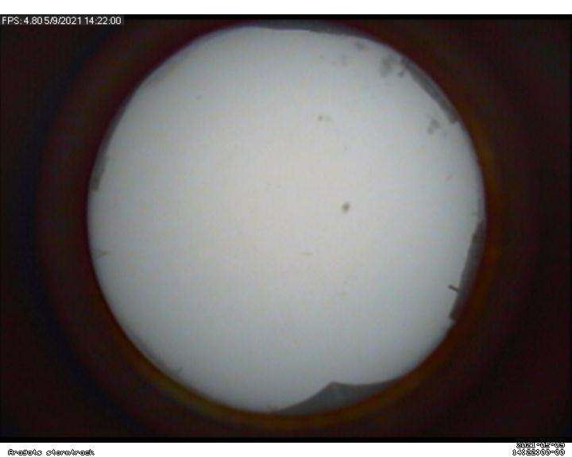
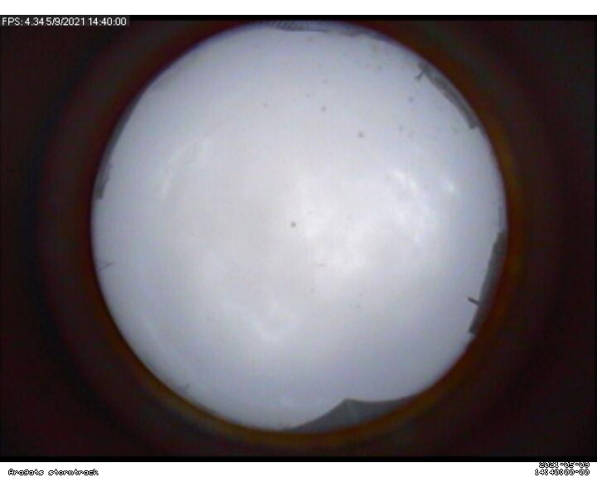
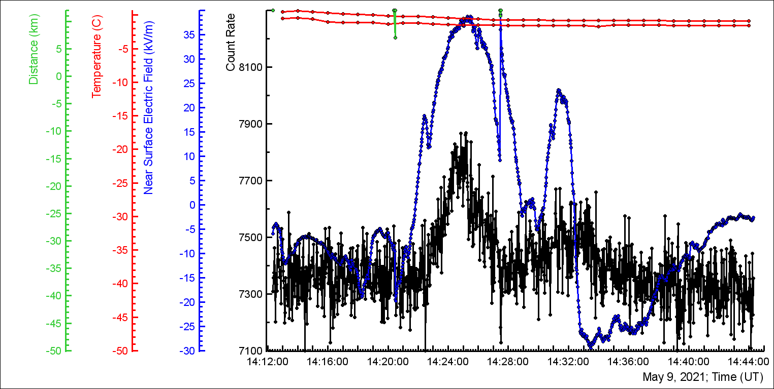

Slide 20
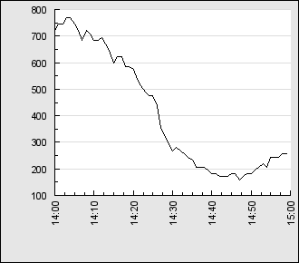
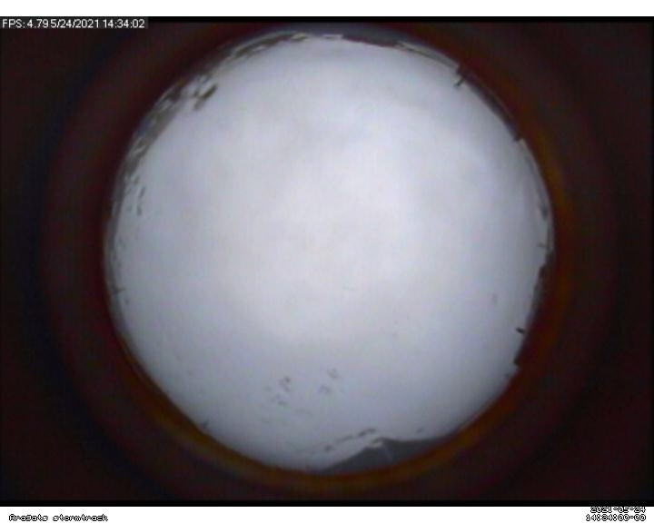


Graupel fall: 14:34 – 14:44. LPCR prevents inverted and –CG flashes
Lightning flashes interrupt RREAs

Slide 21




Start of graupel fall
End of graupel fall

Slide 22




Slide 23




Graupel

Slide 24



Slide 25

Flux enhancement started after recovering of electric field and when flux reaches a threshold lightning flash stop it and it continues many times in few minutes

Slide 26




What is the size of emitting region in cloud? If we assume that the maximum field is where the lightning flashes occur, this size is > 20 km in diameter, and total number of electrons can reach 10^16 (>4 MeV), however is electron acceleration uniform in whole storm? Possibly “black clouds” are seldom?

Slide 27





Slide 28




Multiple nearby flashes terminating TGE

